Slide 1
Hotel Review PREDICTION Pre and Post Pandemic
Data Science Masters Capstone
DATS 6501
Mariko McDougall

Slide 2

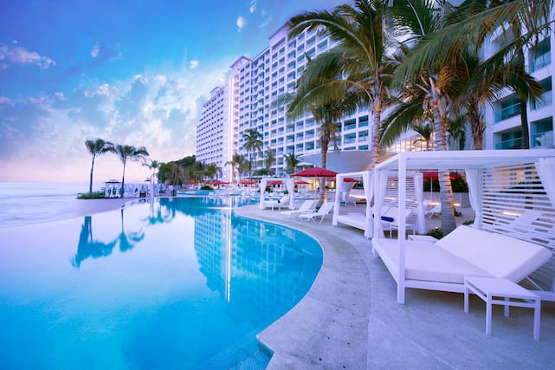
Index
Introduction
Literature Review
Methodology
Results and Analysis
Conclusions
References

Slide 3
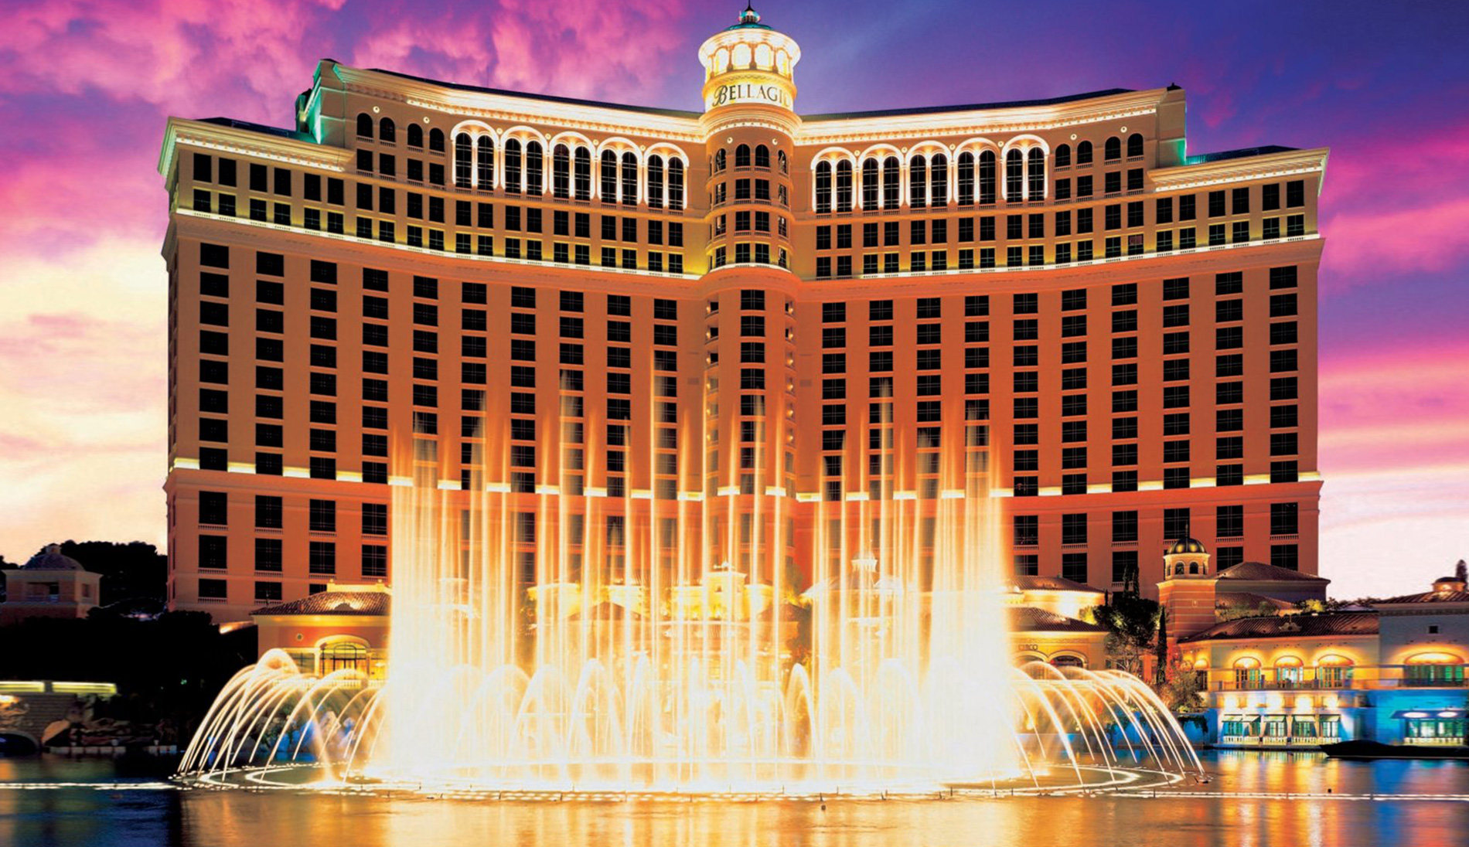
Introduction
The hotel industry, worth over 240 billion dollars globally*, was highly impacted by the Covid-19 pandemic.
In 2020, occupancy declined more than 11%, and 4.4% of hotels permanently closed**.
*Strategic Report - Industry Overview 2020. IHG Hotels and Resorts - Annual reports. (2020).
**Q3 2021 US Hotel Figures. CBREUS Insights and Research. (2021).

Slide 4
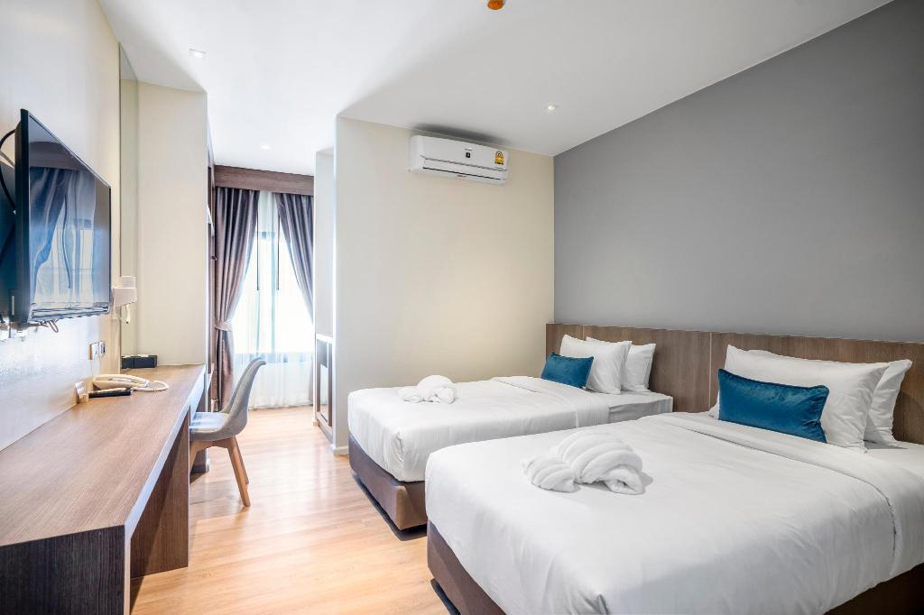
Introduction - Problem Statement and Scope
Problem Statement
Given the hotel industry’s intense competition, knowing what factors have the highest impact on a visitor’s experience is critical to maintaining high review scores, occupancy and profitability.
This is especially true now, as customer priorities may have shifted during the pandemic.
Project Scope
Extract the most informative features from hotel reviews
Train natural language processing (NLP) models on the reviews
Make predictions on the impact of the extracted features, as well as novel review scores

Slide 5
Index
Introduction
Literature Review
Methodology
Results and Analysis
Conclusions
References

Slide 6
Literature Review
Citation | Impact
Alam, M. H., Ryu, W. J., & Lee, S-G. (2016). Joint multi-grain topic sentiment: Modeling semantic aspects for online reviews. Information Sciences, 339, 206-223. https://doi.org/10.1016/j.ins.2016.01.013 | Used a similar TripAdvisor dataset to test a tf-idf-adjacent technique to predict star ratings of reviews. Used as a baseline of comparison for model accuracy.
Gaudette, L., Japkowicz, N. (2009). Evaluation Methods for Ordinal Classification. In: Gao, Y., Japkowicz, N. (eds) Advances in Artificial Intelligence. Canadian AI 2009. Lecture Notes in Computer Science(), vol 5549. Springer, Berlin, Heidelberg. https://doi.org/10.1007/978-3-642-01818-3_25 | Compares the suitability of accuracy and MSE as a metrics for star rating classification evaluation. Ultimately recommends using MSE.
“Combining Categorical and Numerical Features with Text in BERT · Chris McCormick.” n.d. Accessed March 3rd, 2022. https://mccormickml.com/2021/06/29/combining-categorical-numerical-features-with-bert/. | Guidance on integrating non-text features for NLP modeling using transformer models.

Slide 7
Index
Introduction
Literature Review
Methodology
Results and Analysis
Conclusions
References

Slide 8
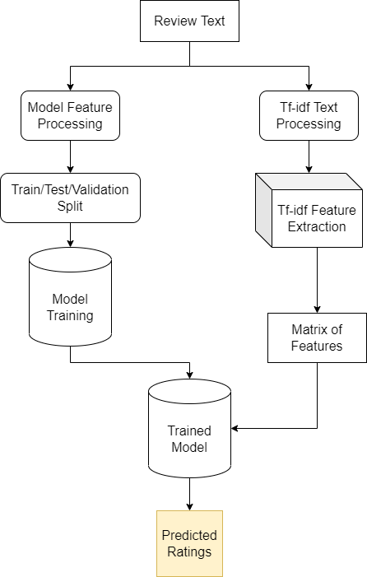
Methodology - Overview
Data Collection
Left Branch
Model Feature Pre-Processing
Modeling
Transformer Models
Ensemble Model
Right Branch
Tf-idf Text Pre-Processing
Tf-idf Feature Extraction
Tf-idf Feature Sampling
Novel Review Prediction

Slide 9
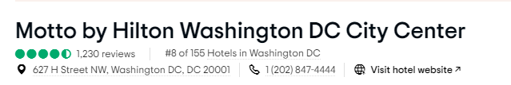
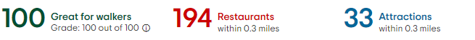
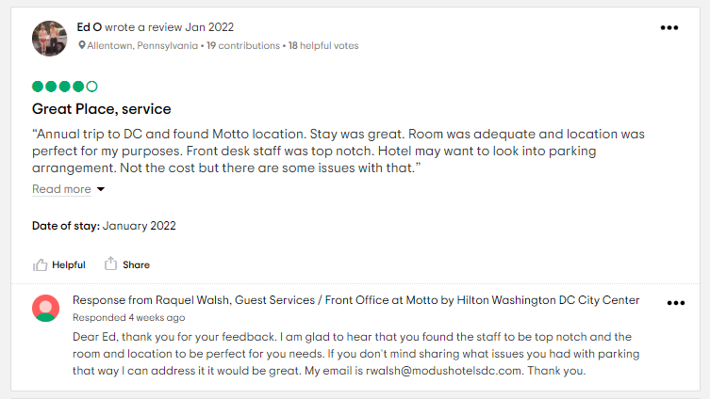
Methodology – Data Collection
Data scraped from TripAdvisor
The most populous city in each state, all hotels with over 50 reviews
Hotel Basic Information Section
Name of hotel and address
Location Information
Walkability Score
Review Information
Review title + Review text
Review date
Binary: Review Written Pre/Post Pandemic Start

Slide 10
Methodology – Model Feature Pre-Processing
Non-text data features were converted to text and prepended to the reviews.
Features integrated into the text:
State: The US state the hotel was in.
Pandemic timing: Before or after the pandemic
Walkability score: TripAdvisor walkability score. Binned in 25 point increments. (0-3)
Notes:
Important to append before the review, or it may be truncated when sending to the model.

Slide 11
Methodology – Model Feature Pre-Processing
Non-text data features were converted to text and prepended to the reviews.
Features integrated into the text:
State: The US state the hotel was in.
Pandemic timing: Before or after the pandemic
Walkability score: TripAdvisor walkability score. Binned in 25 point increments. (0-3)
State NV. Before pandemic. Walkability 2. Clean and comfy. We were a late check in and had no problems at all. The room was clean and the bed was extremely comfortable.
State OH. After pandemic. Walkability 0. Poorly maintained. short sheets and towels and property looks run down. Love the outdoor basketball court though.
Notes:
Important to append before the review, or it may be truncated when sending to the model.

Slide 12
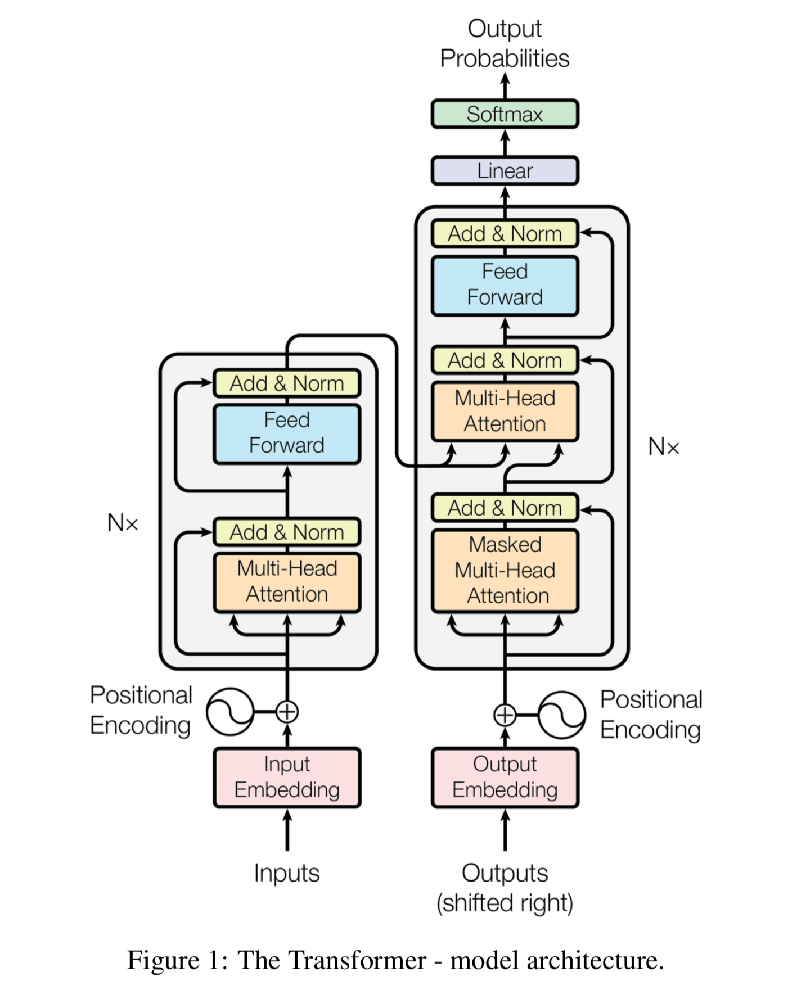
Methodology – Transformer Models
What is a Transformer model?
State-of-the-art NLP model
Processes text with context
Uses attention to weight the importance of each word in the sentence
Trained on huge corpuses of real text
E.g. Wikipedia

Slide 13
Methodology – Transformer Models
ELECTRA
Very lightweight model
Uses replaced token detection, similar to a GAN network, rather than missing tokens
ERNIE 2.0
Larger model than Electra
Better performance than Electra
Uses continual multi-task pre-training to extract more information from training texts
DeBERTa-Small
Largest of the three
Uses disentangled attention to parse word position as well as identity
Notes:
Electra – 110M, Ernie 340M, DeBERTa 1.5B

Slide 14
Methodology – Ensemble Models
Data
Ensemble Learning
Meta approach to modeling
Leverages the power of multiple predictive models
Gradient Boosting
A weak learner frequently used in ensemble learning
Tends to be better at boosting input differences compared to a Random Forest
ELECTRA
ERNIE
DeBERTa
Gradient Boost
Predictions

Slide 15
Methodology - Overview
Data Collection
Left Branch
Model Feature Pre-Processing
Modeling
Transformer Models
Ensemble Model
Right Branch
Tf-idf Text Pre-Processing
Tf-idf Feature Extraction
Tf-idf Feature Sampling
Novel Review Prediction

Slide 16
Methodology – Tf-idf Feature Extraction
Tf-idf is a statistic relating to the importance of a term within a set of documents
Can extract individual words (unigrams) or word-pairs (bigrams)
Tf-idf Text Processing
Tokenizing
Removing stop words
Lemmatizing
Removing punctuation, isolated numbers, etc.
“I was sleeping like a log - The pillowss were so soft!1”
i, was, sleeping, like, a, log, -, the, pillowss, were, so, soft, !, 1, !
sleeping, log, -, pillowss, soft, !, 1, !
sleep, log, -, pillow, soft, !, 1, !
sleep, log, pillow, soft
Feature extraction performed using sklearn’s TfidfVectorizer on the prepared text for all reviews
Top 100 features Pre and Post Pandemic were used

Slide 17
Methodology – Tf-idf Feature Sampling
To sample the model’s response to the tf-idf features, standardized sentences were generated.
Features integrated:
State: the US state abbreviation.
Pandemic timing: Before or after the pandemic
Walkability score: Derived from the TripAdvisor walkability score. Binned in 25 point increments.
tf-idf feature: Combined set from the top 100 features from pre-covid and post-covid review sets. (Total 118)
Sentiment: 20 synonyms for “good” or “bad” were used to sample positive and negative sentiment.
All combinations of these factors were generated

Slide 18
Methodology – Tf-idf Feature Sampling
To sample the model’s response to the tf-idf features, standardized sentences were generated.
Features integrated:
State: the US state abbreviation.
Pandemic timing: Before or after the pandemic
Walkability score: Derived from the TripAdvisor walkability score. Binned in 25 point increments.
tf-idf feature: Combined set from the top 100 features from pre-covid and post-covid review sets. (Total 118)
Sentiment: 20 synonyms for “good” or “bad” were used to sample positive and negative sentiment.
All combinations of these factors were generated
State KS. After pandemic. Walkability 1. Area deplorable.
State AZ. After pandemic. Walkability 0. Staff subpar.
State ME. Before pandemic. Walkability 3. Food enchanting.
State NM. After pandemic. Walkability 2. Lobby entertaining.

Slide 19
Index
Introduction
Literature Review
Methodology
Results and Analysis
Conclusions
References

Slide 20
Results & Analysis – Data Sampling
In total, 3,774,238 reviews were scraped
Data were stratified by state and pandemic timing, and approx. 3,000 Reviews per state were sampled
Some states did not have 1,500 reviews written post-pandemic.
In this case all post-pandemic reviews were used
Total of 146,438 reviews
Statistic | Pre-Pandemic | Pandemic
Total Reviews | 3,442,834 | 331,404
Mean Rating | 4.10 | 3.81
STD of Ratings | 1.16 | 1.50
Train/Test/Validation Split were stratified by review rating
60/20/20

Slide 21
Results & Analysis – Ensemble Results
Ensemble Result: Better performance in both metrics than any individual model
Notes:
Part of what makes the results very similar, and the ensemble less effective than expected is that they often made errors on the same test cases. These were often reviews that had discordant review ratings and text, or ones with edits that change the rating dramatically, but are short in length.

Slide 22
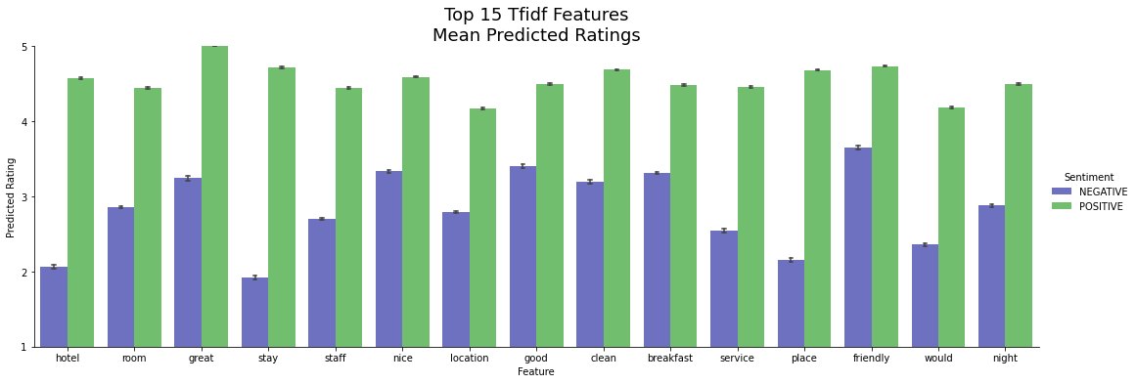
Results & Analysis – Tf-idf Feature Sampling

Slide 23
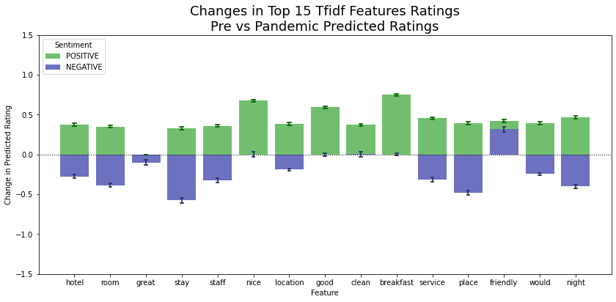
Results & Analysis – Tf-idf Feature Sampling

Slide 24
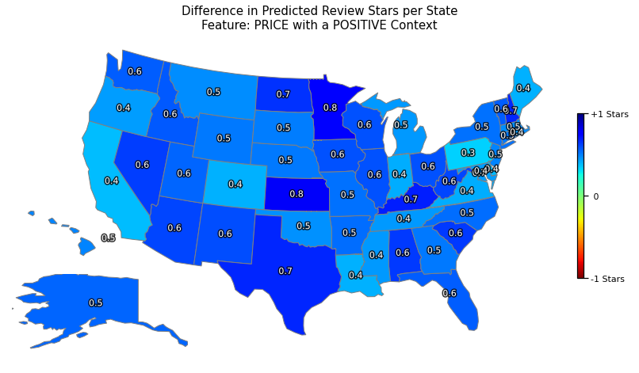
Results & Analysis – Tf-idf Feature Sampling

Slide 25
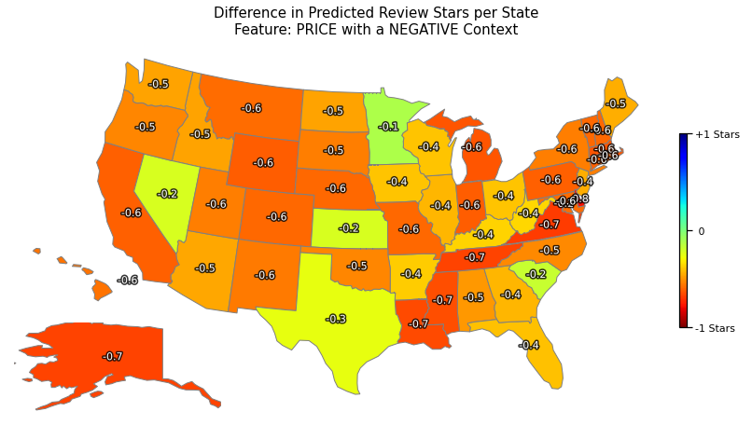
Results & Analysis – Tf-idf Feature Sampling

Slide 26
Results & Analysis – Novel Sentences
Sentence | Predicted Rating
The lobby in this hotel is dated. | 2
The lobby in this hotel is newly renovated. | 4
The lobby in this hotel is a little dated, but very clean. | 3
The lobby in this hotel is a little dated, but newly painted. | 3
The lobby in this hotel a little dated, but has free coffee. | 2

Slide 27
Results & Analysis – Novel Sentences
Sentence | Predicted Rating
The lobby in this hotel is dated. | 2
The lobby in this hotel is newly renovated. | 4
The lobby in this hotel is a little dated, but very clean. | 3
The lobby in this hotel is a little dated, but newly painted. | 3
The lobby in this hotel a little dated, but has free coffee. | 2

Slide 28
Results & Analysis – Novel Sentences
Sentence | Predicted Rating
The lobby in this hotel is dated. | 2
The lobby in this hotel is newly renovated. | 4
The lobby in this hotel is a little dated, but very clean. | 3
The lobby in this hotel is a little dated, but newly painted. | 3
The lobby in this hotel a little dated, but has free coffee. | 2

Slide 29
Results & Analysis – Novel Sentences
Sentence | Predicted Rating
The lobby in this hotel is dated. | 2
The lobby in this hotel is newly renovated. | 4
The lobby in this hotel is a little dated, but very clean. | 3
The lobby in this hotel is a little dated, but newly painted. | 3
The lobby in this hotel a little dated, but has free coffee. | 2

Slide 30
Index
Introduction
Literature Review
Methodology
Results and Analysis
Conclusions
References

Slide 31
Conclusions
Predicted Tf-idf Feature Importance
Different features of reviews have variable impacts on the predicted ratings
This impact seems strongest in negative context
During the pandemic
Many positive features increased in positivity
Negative features both increased and decreased depending on the feature
Regional Predicted Tf-idf Feature Importance
Regionality plays a role in determining rating for a given feature
Novel Sentence Prediction
The ensemble model can be used to predict the impact of changes to the hotel on review scores, and could be used as a guide for how to best optimize financial expenditure.

Slide 32
Project Limitations & Future Research
Limitations
A character limit on both Electra and Ernie truncated longer reviews
Imposes a limit on the number of features that can be added
Computational resources were limited to those within budget (Google Colab Pro)
Future Research
Implementing more powerful models in the ensemble
Implementing more post-pandemic samples into the training sets
Exploring the effect of seasonality in the data

Slide 33
References
Alam, Md Hijbul, Woo Jong Ryu, and Sang-Geun Lee. 2016a. “Joint Multi-Grain Topic Sentiment: Modeling Semantic Aspects for Online Reviews.” Information Sciences 339 (April): 206–23. https://doi.org/10.1016/j.ins.2016.01.013.
2016b. “Joint Multi-Grain Topic Sentiment: Modeling Semantic Aspects for Online Reviews.” Information Sciences 339 (April): 206–23. https://doi.org/10.1016/j.ins.2016.01.013.
Baccianella, Stefano, Andrea Esuli, and Fabrizio Sebastiani. 2009. “Evaluation Measures for Ordinal Regression.” In 2009 Ninth International Conference on Intelligent Systems Design and Applications, 283–87. https://doi.org/10.1109/ISDA.2009.230.
Bird, S., Klein, E., & Loper, E. (2009). Natural Language Processing with Python: Analyzing Text with the Natural Language Toolkit. O'Reilly Media, Inc.
Boyagane, Isuru. 2020. “How Important Are the Words in Your Text Data? Tf-Idf Answers….” Medium. December 24, 2020. https://towardsdatascience.com/how-important-are-the-words-in-your-text-data-tf-idf-answers-6fdc733bb066.
Clark, Kevin, Minh-Thang Luong, and Quoc V Le. 2020. “ELECTRA: PRE-TRAINING TEXT ENCODERS AS DISCRIMINATORS RATHER THAN GENERATORS,” 18.
“Combining Categorical and Numerical Features with Text in BERT · Chris McCormick.” n.d. Accessed April 11, 2022a. https://mccormickml.com/2021/06/29/combining-categorical-numerical-features-with-bert/.
“Correcting Words Using NLTK in Python.” 2021. GeeksforGeeks (blog). July 18, 2021. https://www.geeksforgeeks.org/correcting-words-using-nltk-in-python/.
“Feature Extraction Techniques - NLP.” 2020. GeeksforGeeks (blog). March 3, 2020. https://www.geeksforgeeks.org/feature-extraction-techniques-nlp/.
Figueroa, Rosa L., Qing Zeng-Treitler, Sasikiran Kandula, and Long H. Ngo. 2012. “Predicting Sample Size Required for Classification Performance.” BMC Medical Informatics and Decision Making 12 (1): 8. https://doi.org/10.1186/1472-6947-12-8.
Ganesan, Kavita. 2018. “Python Keyword Extraction Tutorial Using TF-IDF.” Kavita Ganesan, PhD (blog). August 2, 2018. https://kavita-ganesan.com/python-keyword-extraction/.
Gaudette, Lisa, and Nathalie Japkowicz. 2009a. “Evaluation Methods for Ordinal Classification.” In Advances in Artificial Intelligence, edited by Yong Gao and Nathalie Japkowicz, 207–10. Berlin, Heidelberg: Springer. https://doi.org/10.1007/978-3-642-01818-3_25.
Guo, S.; Wang, Q. Application of Knowledge Distillation Based on Transfer Learning of ERNIE Model in Intelligent Dialogue Intention Recognition. Sensors 2022, 22, 1270. https://doi.org/10.3390/s22031270
Hao, Yaru, Li Dong, Hangbo Bao, Ke Xu, and Furu Wei. 2021. “Learning to Sample Replacements for ELECTRA Pre-Training.” In Findings of the Association for Computational Linguistics: ACL-IJCNLP 2021, 4495–4506. Online: Association for Computational Linguistics. https://doi.org/10.18653/v1/2021.findings-acl.394.
He, Pengcheng, Xiaodong Liu, Jianfeng Gao, and Weizhu Chen. 2020. “DEBERTA: DECODING-ENHANCED BERT WITH DISENTANGLED ATTENTION.” In . https://openreview.net/forum?id=XPZIaotutsD.
“Hugging Face – The AI Community Building the Future.” n.d. Accessed April 11, 2022. https://huggingface.co/.
Nageshkar, Prasad. 2021. “Multi-Label Text Classification Using Transformers(BERT).” Analytics Vidhya (blog). March 15, 2021. https://medium.com/analytics-vidhya/multi-label-text-classification-using-transformers-bert-93460838e62b.
Q3 2021 US Hotel Figures. CBREUS Insights and Research. (2021). Retrieved January 21, 2022, from Q3 2021 US Hotel Figures
Rajapakse, Thilina. 2020. “Understanding ELECTRA and Training an ELECTRA Language Model.” Medium. April 12, 2020. https://towardsdatascience.com/understanding-electra-and-training-an-electra-language-model-3d33e3a9660d.
Sun, Yu, Shuohuan Wang, Yukun Li, Shikun Feng, Hao Tian, Hua Wu, and Haifeng Wang. 2019. “ERNIE 2.0: A Continual Pre-Training Framework for Language Understanding.” ArXiv:1907.12412 [Cs], November. http://arxiv.org/abs/1907.12412.
Strategic Report - Industry Overview 2020. IHG Hotels and Resorts - Annual reports. (2020). Retrieved January 20, 2022, from https://www.ihgplc.com/-/media/FBBD6EBDD4D14EAD88A08E62F7911E74.ashx
Vivek, Sowmya. 2018. “Automated Keyword Extraction from Articles Using NLP.” Analytics Vidhya (blog). December 17, 2018. https://medium.com/analytics-vidhya/automated-keyword-extraction-from-articles-using-nlp-bfd864f41b34.
Yao, Y.Y. 1995. “Measuring Retrieval Effectiveness Based on User Preference of Documents.” Journal of the American Society for Information Science 46 (2): 133–45. https://doi.org/10.1002/(SICI)1097-4571(199503)46:2<133::AID-ASI6>3.0.CO;2-Z.

Slide 34
Thank you for Listening
Any Questions?

Slide 35
Supplemental Slides

Slide 36
Methodology – Data Sampling - Insufficient States
State | Pre-Pandemic | Pandemic
DE | 7,667 | 817
IA | 12,892 | 1,009
KS | 20,364 | 1,376
MI | 25,153 | 1,463
MS | 7,748 | 562
MT | 17,121 | 1,093
NH | 11,147 | 589
NJ | 27,067 | 1,065
ND | 14,845 | 869
RI | 18,296 | 966
SD | 21,134 | 1,452
WV | 12,552 | 685
WY | 10,224 | 992
In total, 3,774,238 reviews were scraped
Data were stratified by state and pandemic timing, and approx. 3000 Reviews per state were sampled
Some states did not have 1500 reviews during the pandemic – in this case all were used
These states are displayed on the right
Total of 146,438 reviews

Slide 37
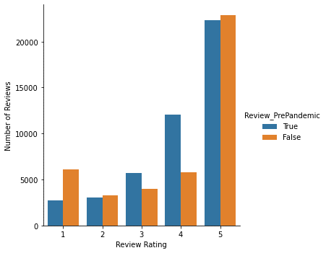
Data Sampling – Star Ratings and the Pandemic
Star rating proportions were not consistent pre-and post-pandemic. There is a skew towards extreme ratings, either 1 or 5 stars, with less of the intermediate star ratings.
This could be a contributing factor to the post-pandemic trend of star rating increase post pandemic.
There are not more extremely positive reviews, but there are less mostly positive reviews.

Slide 38
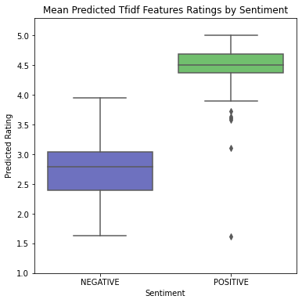
Results & Analysis – Tf-idf Feature Sampling
Positive sentiment has a very narrow distribution across all features
Implies that the model is mainly fixating on sentiment
Outliers tend to be neutral verbs, such as ‘make’
Negative sentiment has much wider distribution, varies by feature
Implies that the model is identifying features and taking them into consideration.

Slide 39
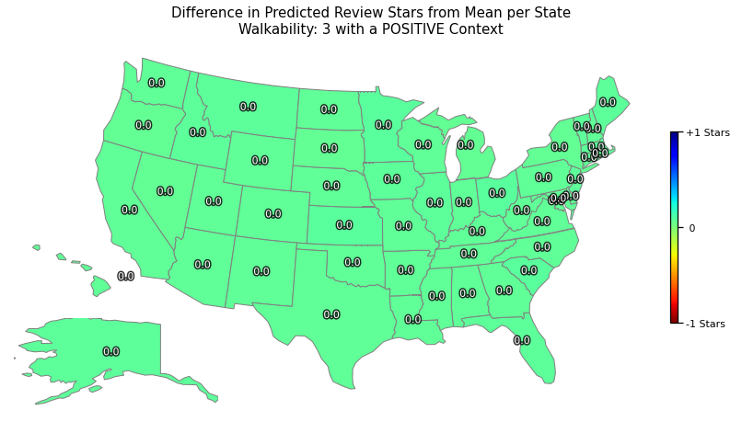
Results & Analysis – Walkability
Walkability and Review Score
Pearson’s Correlation: 0.122
Frequency of High Walkability and Review Score
Pearson’s Correlation: 0.558

Slide 40
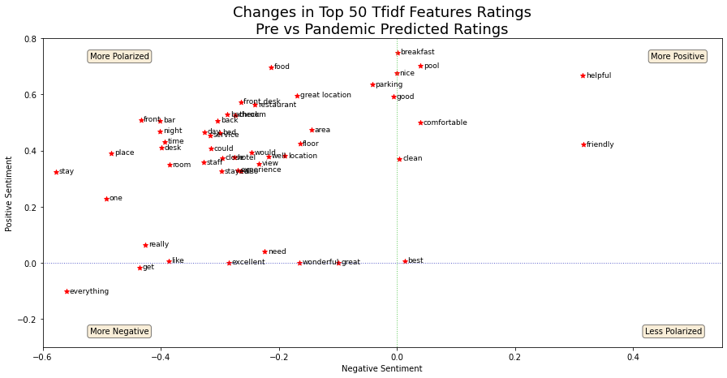
Results & Analysis – Tf-idf Feature Sampling

Slide 41

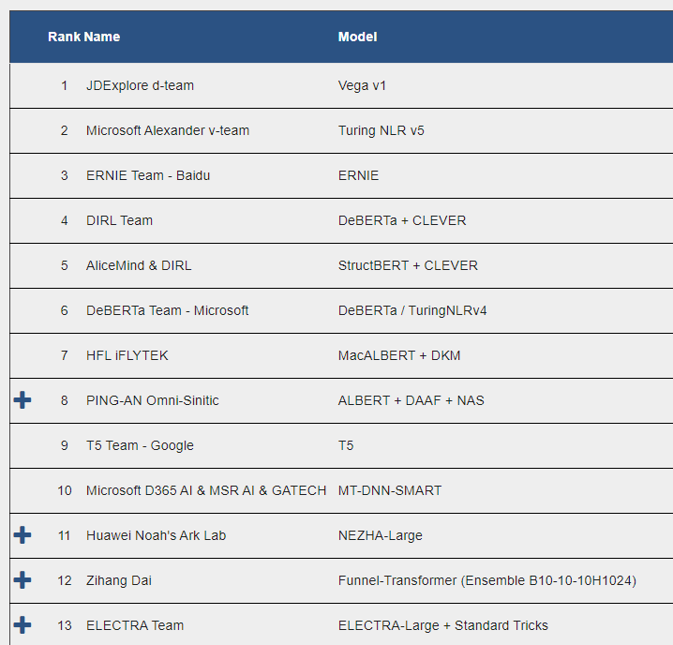
Methodology – Transformer Models
ELECTRA
Very lightweight model (110M parameters)
Uses replaced token detection, similar to a GAN network, rather than missing tokens
Performance exceeds human baselines (rank 21)
ERNIE 2.0
3rd ranked on the leaderboard
Much larger model than Electra (340M parameters)
DeBERTa
4th ranked on the leaderboard (1.5B parameters)
BERT-based model – different base framework than ERNIE
…
Notes:
Note: Didn’t use Turing because it is 530 billion parameters – just loading it would exceed computational capacity.

Slide 42
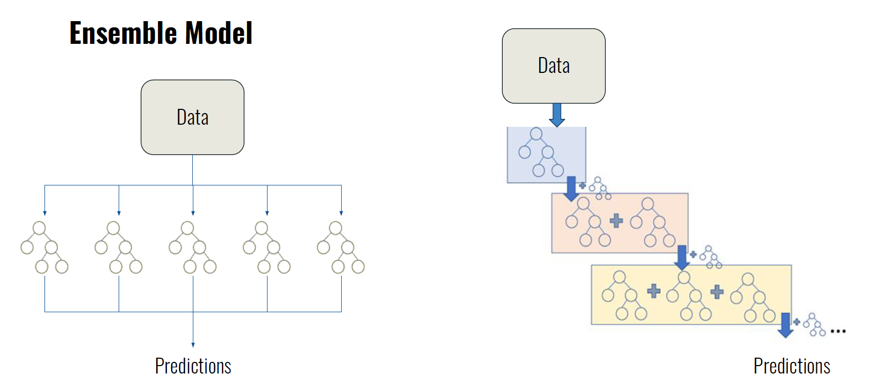
Methodology – Ensemble Models
Gradient Boosting
A weak learner frequently used in ensemble learning
Builds decision trees sequentially based on the error of the previous tree
Amplifies signal, but can also amplify noise
Random Forest
Builds all trees simultaneously, independent of the other trees
Less likely to overfit
Also frequently used in ensemble learning
Random Forest Model
Gradient Boosting Model

Slide 43
Methodology – Tf-idf Feature Extraction
TfidfVectorizer
Tf-idf : Term-frequency * Inverse Document Frequency
Scales down the impact of frequent tokens
CountVectorizer
Converts the cleaned tokens into a sparse matrix of token counts
Extract unigrams and bigrams
Individual words, and the individual word +1, captures relationships.
Maximum 10000 features
Ensures that uncommon words (typos, proper names) are not represented
TfidfTransformer
Converts the sparse matrix from CountVectoriser into tf-idf

Slide 44
Results & Analysis – Tf-idf Feature Extraction
Ranking | Pre-Pandemic | Pandemic
0 | hotel | room
1 | room | hotel
2 | great | great
3 | stay | stay
4 | staff | staff
5 | nice | clean
6 | location | nice
7 | good | service
8 | clean | location
9 | breakfast | time
10 | service | good

Slide 45
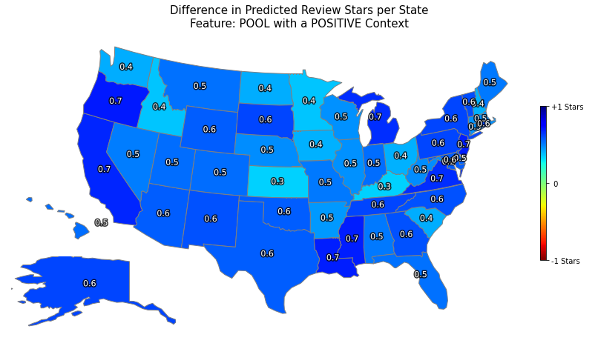
Results & Analysis – Tf-idf Feature Sampling

Slide 46
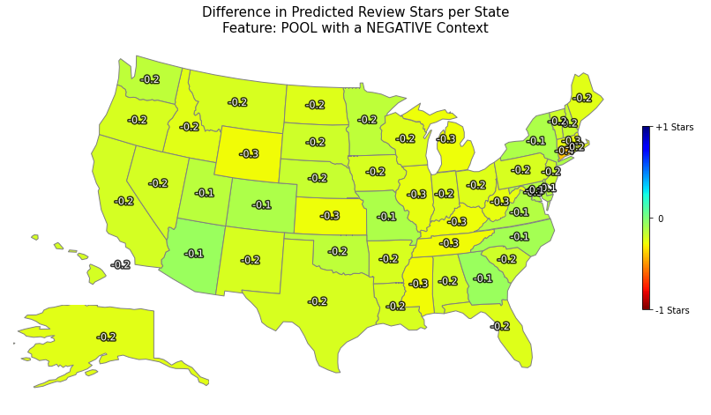
Results & Analysis – Tf-idf Feature Sampling

Slide 47
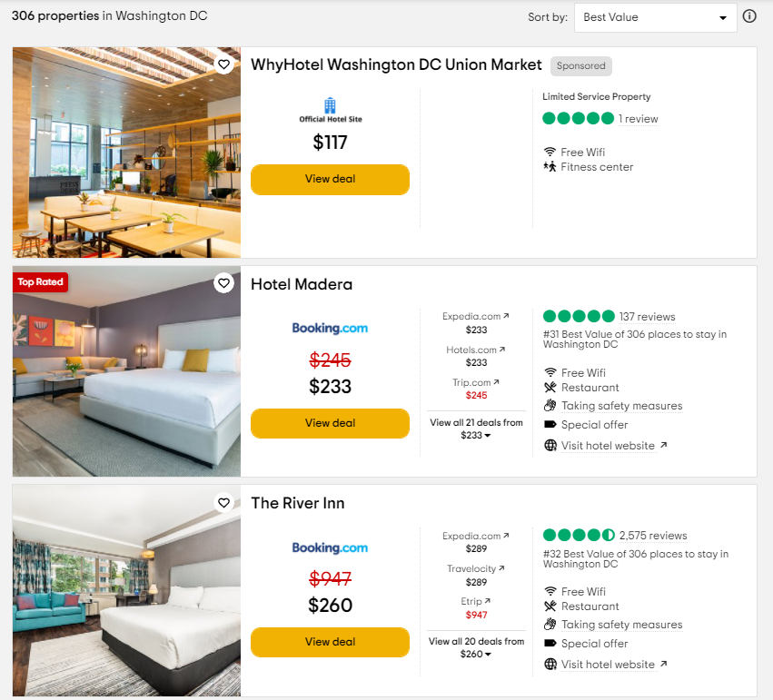
Dataset - Cities
For each State, download reviews for the most populous city
Exception: Connecticut – New Haven instead of Bridgeport
For each City, capture the number of properties, and loop through all pages of listings.
Hotel Listing
Collect link to hotel page if there are more than 50 reviews for the property
This saves time, especially as many small properties do not have any reviews.
Page Sorting
The default sorting system weights for number of reviews, as well as star rating and cost
Once more than half of the page has less than 50 reviews, stop scraping for hotel links.

Slide 48
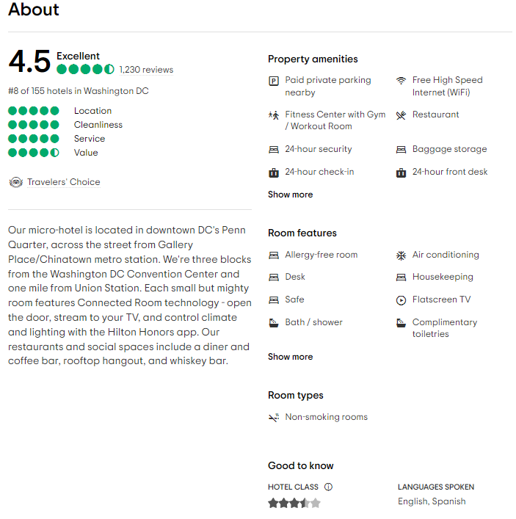
Methodology – Data Collection
Hotel ID
Unique ID code combining the city and hotel ID
Hotel Basic Information Section
Hotel name
Number of reviews
Hotel address
About Section
Hotel blurb
Property amenities and Room features
Hotel star rating
Location Section
Walkability score
Restaurants within distance
Attractions within distance

Slide 49
Methodology - Data Collection
Hotel ID
Review Information
Star rating
Title
Text of the actual review
Date of the stay
Reviewer Information
Date review written
Reviewer home location
Maximum of 4000 reviews per hotel
Necessary, as many large hotels have 30,000+ reviews, and reviews are displayed in increments of 5.
For most highly reviewed hotels, this puts us into reviews from 2017.

Slide 50
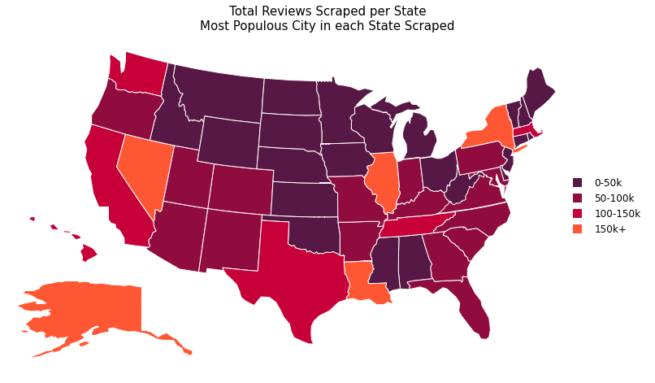
Results & Analysis– Reviews by State
Notes:
Min value: Mississippi with 8310 reviews, max Nevada with 299,316

Slide 51
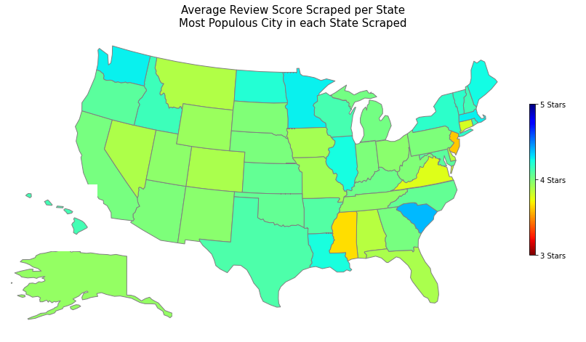
Results & Analysis – Average Review by State

Slide 52
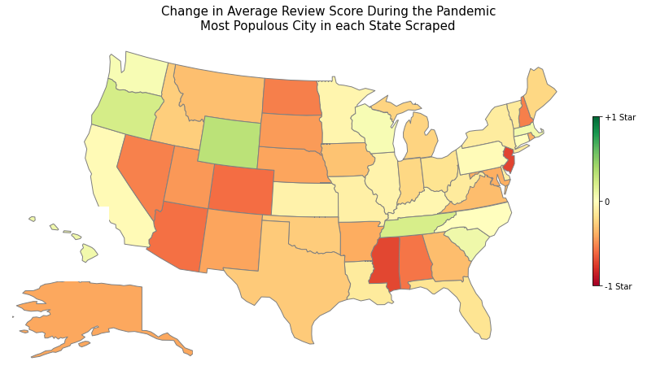
Results & Analysis – Change in Reviews

Slide 53
Results & Analysis – Model Feature Engineering
Feature Engineering
Additional features were prepended to the reviews to augment the information the transformers had available.
Non-text data features were converted to text prior to prepending.
For each feature added, an ERNIE model was trained and tested on a small sample and compared against a baseline trained on review only.
Features | Accuracy | MSE
Predict most frequent rating | 0.489 | 2.412
Review body only | 0.751 | 0.313
Review body + Pandemic Timing | 0.754 | 0.320
Review body + Pandemic Timing + State | 0.754 | 0.319
Review body + Pandemic Timing + State + Walkability | 0.754 | 0.315

Slide 54
Results & Analysis – Non-prepended Feature Engineering
Features | Accuracy | MSE
Predict most frequent rating | 0.4739 | 2.467
Review body only | 0.6993 | 0.402
Review body + Pandemic Timing | 0.6814 | 0.400
Review body + Pandemic Timing + State | 0.6895 | 0.410
Review body + Pandemic Timing + State + Walkability | 0.64215 | 0.542
Review body + Walkability | 0.68627 | 0.423
Review body + State | 0.6732 | 0.4722
Review body + State + Walkability | 0.6797 | 0.435

